Slide 1

Boolean Algebras and Boolean Functions

Slide 2

Boolean algebras and Boolean functions

Slide 3
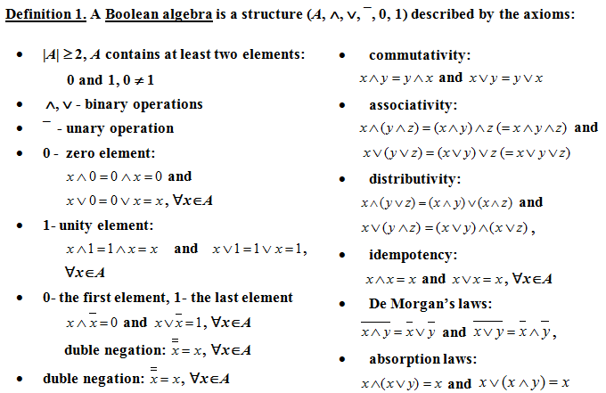
Boolean Algebra

Slide 4
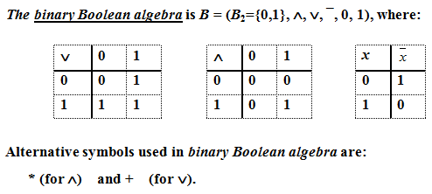
Example 1

Slide 5
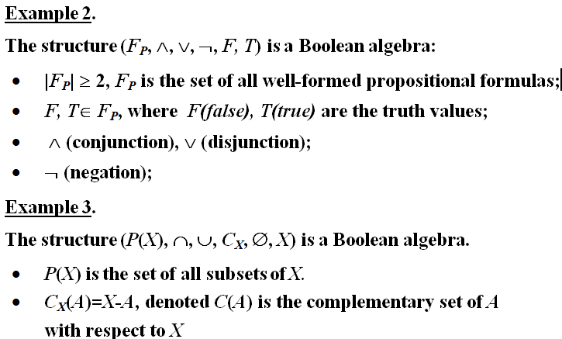

Slide 6
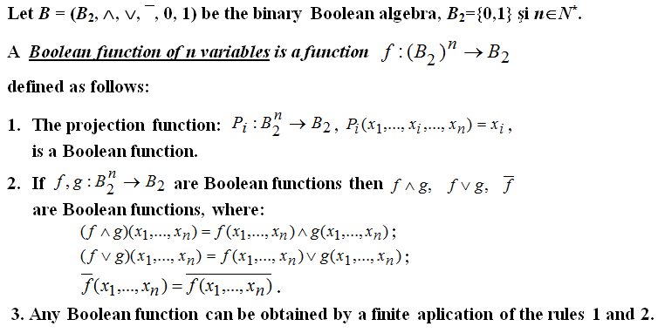
Boolean functions

Slide 7
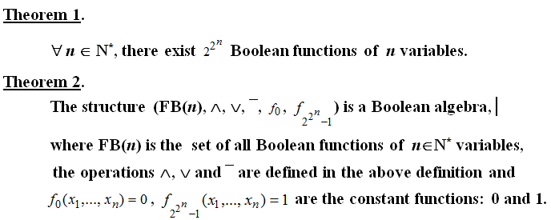
Theorems

Slide 8

Example 4

Slide 9




Slide 10
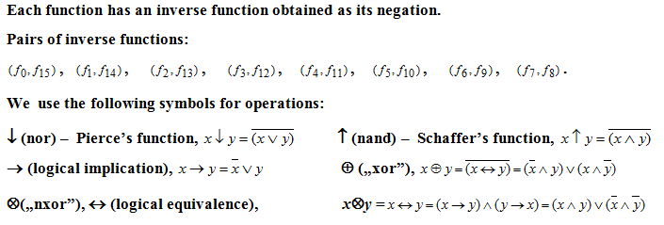
Example 5 (contd.)

Slide 11
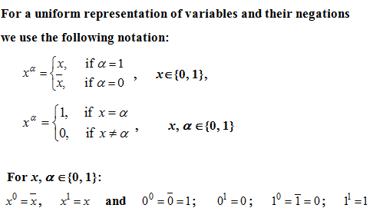
Notations

Slide 12
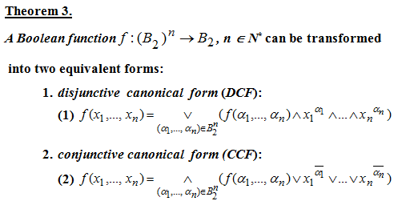
Canonical forms of Boolean functions

Slide 13
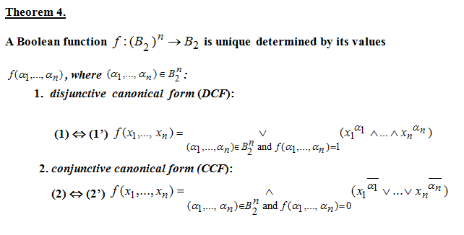
Canonical forms of Boolean functions

Slide 14
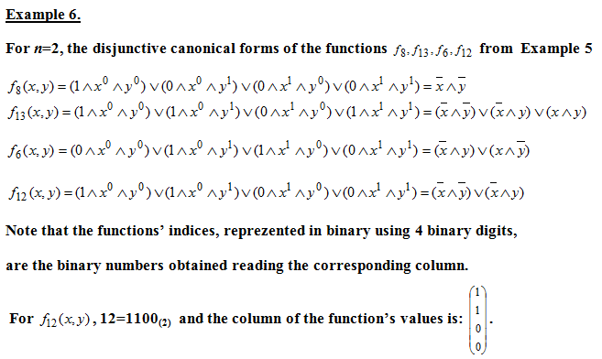

Slide 15
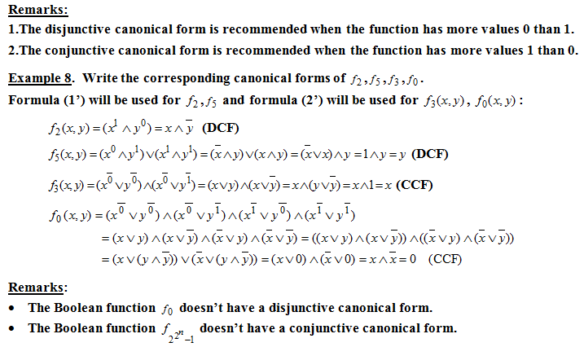

Slide 16
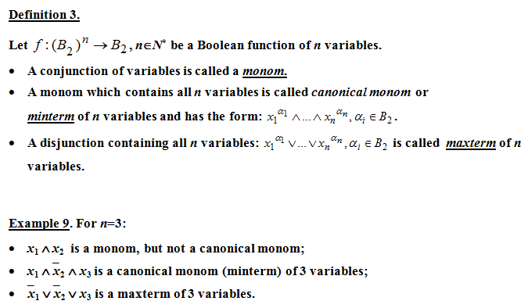
Minterms and Maxterms

Slide 17
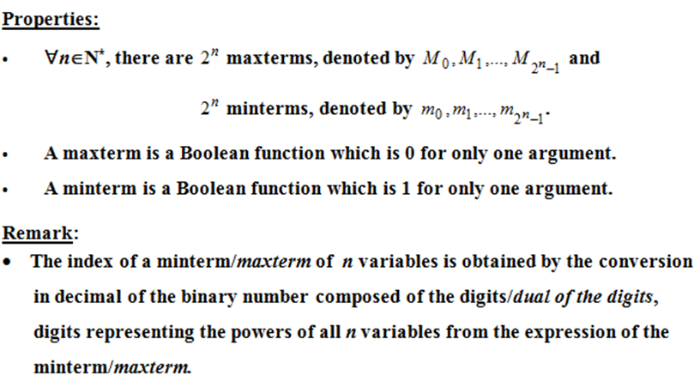
Minterms and maxterms - properties

Slide 18

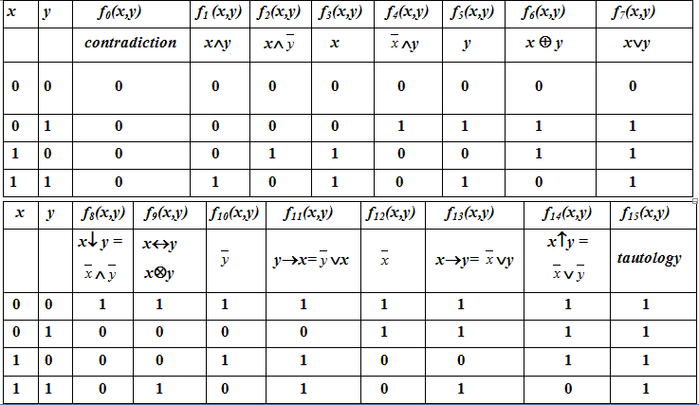

Slide 19
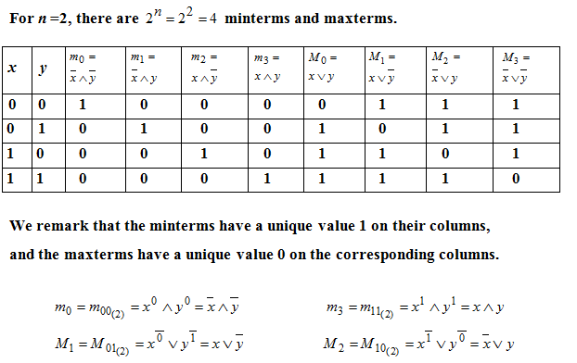
Example 10

Slide 20

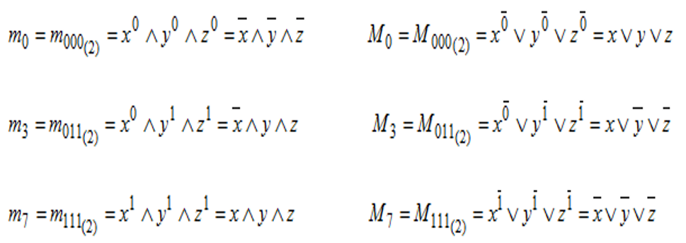
Example 11

Slide 21
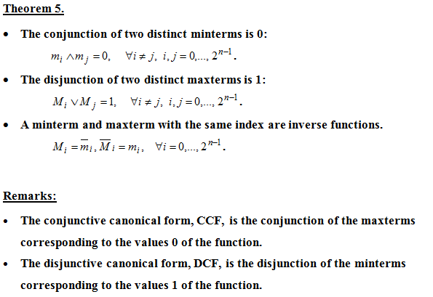

Slide 22
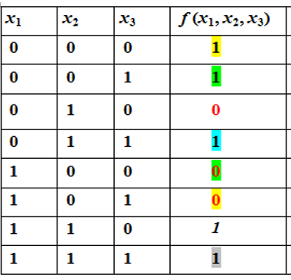
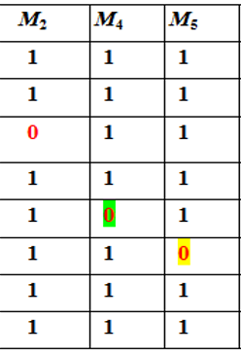
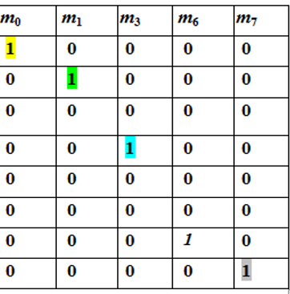

Example 12 Write the canonical forms of the function.

Slide 23
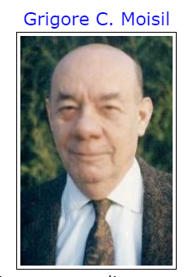

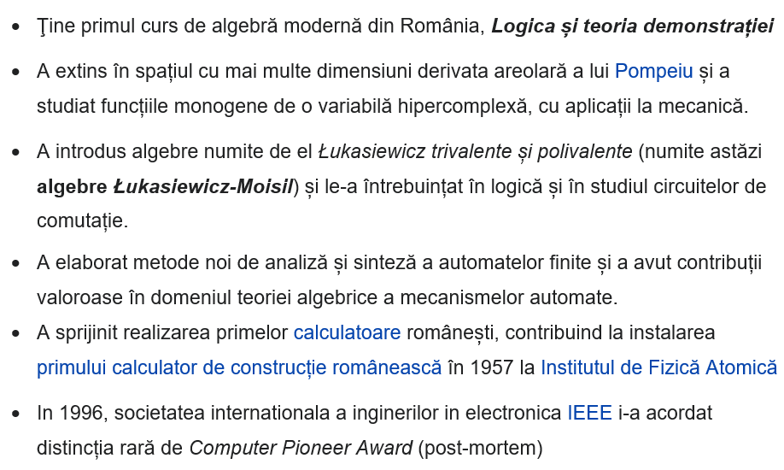
(1906 -1973)
https://www.youtube.com/watch?v=vALliqzw_SU

Slide 24
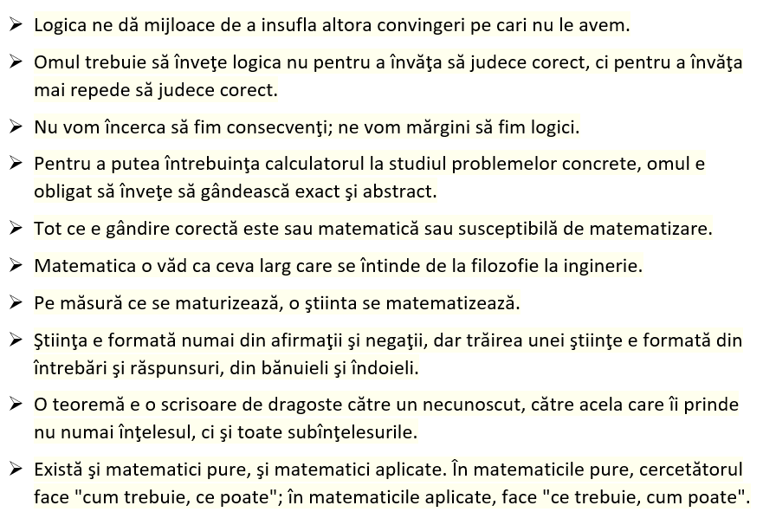
Moisil – citate celebre

Slide 25
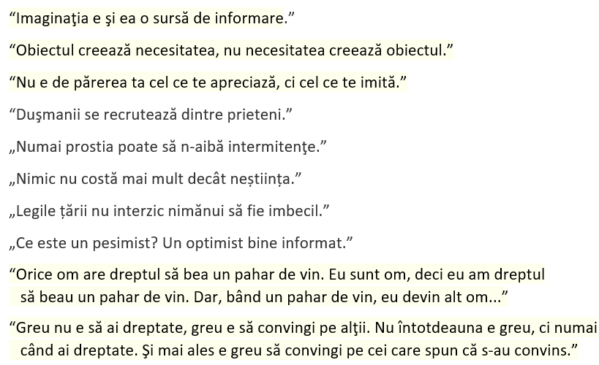
Moisil – citate celebre

